Slide 1
5
INVERSE FUNCTIONS

Slide 2
5.1
Inverse Functions

Slide 3
INVERSE FUNCTIONS
The common theme that links the functions of this chapter is:
They occur as pairs of inverse functions.
In particular, two among the most important functions that occur in mathematics and its applications are:
The exponential function f(x) = a^{x}.
The logarithmic function g(x) = log_{a}x, the inverse of the exponential function.

Slide 4
INVERSE FUNCTIONS
Here we investigate their properties, compute their derivatives, and use them to describe exponential growth and decay in biology, physics, chemistry, and other sciences.
We also study the inverses of the trigonometric and hyperbolic functions. Finally we look at a method (l’Hospital’s Rule) for computing limits of such functions.

Slide 5
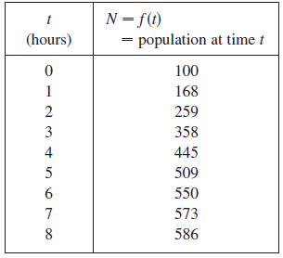
Inverse Functions
Table 1 gives data from an experiment in which a bacteria culture started with 100 bacteria in a limited nutrient medium; the size of the bacteria population was recorded at hourly intervals. The number of bacteria N is a function of the time t: N = f (t).
Table 1

Slide 6
Inverse Functions
Suppose, however, that the biologist changes her point of view and becomes interested in the time required for the population to reach various levels.
In other words, she is thinking of t as a function of N.
This function is called the inverse function of f, denoted by
f ⁻¹, and read as “f inverse.”

Slide 7
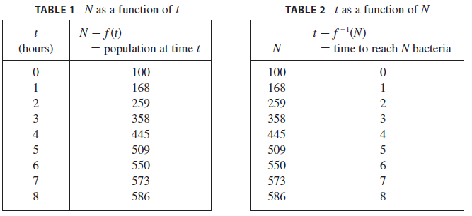
Inverse Functions
Thus t = f ⁻¹ (N) is the time required for the population level to reach N. The values of f ⁻¹ can be found by reading Table 1 from right to left or by consulting Table 2.
For instance, f ⁻¹ (550) = 6 because f (6) = 550.

Slide 8
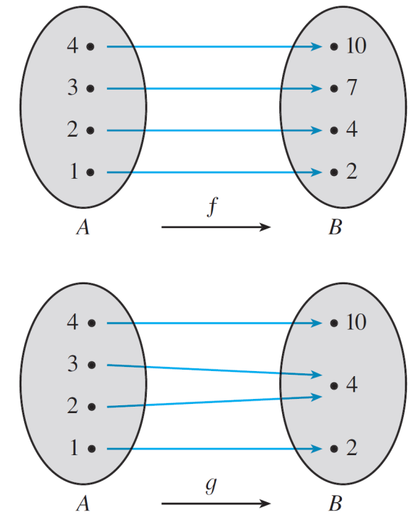
Inverse Functions
Not all functions possess inverses.
Let’s compare the functions f and g whose arrow diagrams are shown in Figure 1.
f is one-to-one; g is not.
Figure 1

Slide 9


Inverse Functions
Note that f never takes on the same value twice (any two inputs in A have different outputs), whereas g does take on the same value twice (both 2 and 3 have the same output, 4). In symbols,
but whenever x₁ ≠ x₂
Functions that share this property with f are called one-to-one functions.

Slide 10
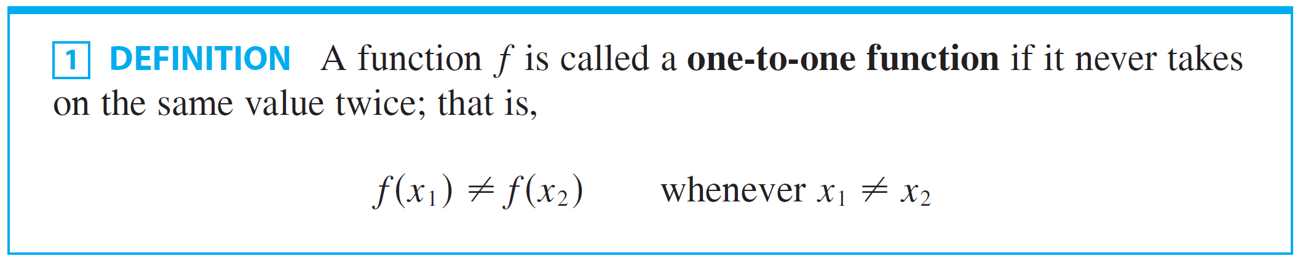
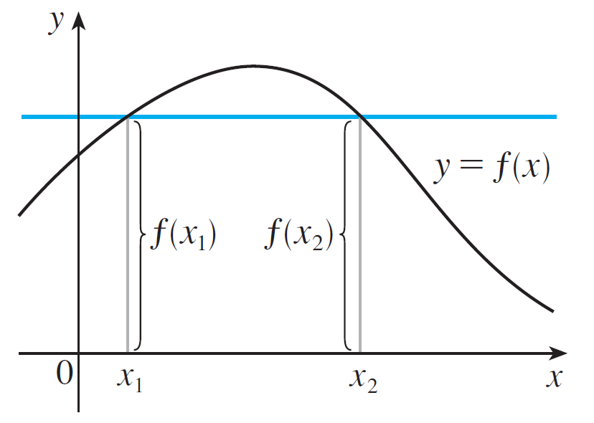
Inverse Functions
If a horizontal line intersects the graph of f in more than one point, then we see from Figure 2 that there are numbers x₁ and x₂ such that f (x₁) = f (x₂).
This function is not one-to-one
because f (x₁) = f (x₂).
Figure 2

Slide 11
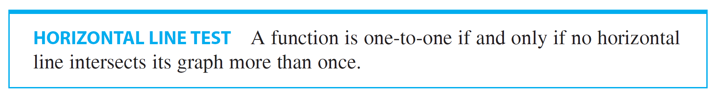
Inverse Functions
This means that f is not one-to-one. Therefore we have the following geometric method for determining whether a function is one-to-one.

Slide 12
Example 1
Is the function f (x) = x³ one-to-one?

Slide 13

Example 1 - Solution 1
SOLUTION 1:
If x₁ ≠ x₂, then (two different numbers can’t have the same cube). Therefore, by Definition 1, f (x) = x³ is one-to-one.

Slide 14
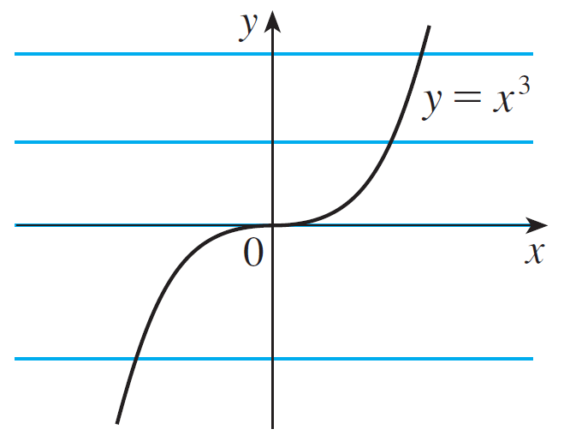
Example 1 – Solution 2
cont’d
f (x) = x³ is one-to-one.
Figure 3
SOLUTION 2:
From Figure 3 we see that no horizontal line intersects the graph of f (x) = x³ more than once. Therefore, by the Horizontal Line Test, f is one-to-one.

Slide 15
Example 2
Is the function g(x) = x² one-to-one?
SOLUTION 1:
The function is not one-to-one.
This is because, for instance, g(1) = 1 = g(– 1) and so 1 and – 1 have the same output.

Slide 16
Example 2 SOLUTION 2
From Figure 4, we see that there are horizontal lines that intersect the graph of g more than once.
So, by the Horizontal Line Test, g is not one-to-one.

Slide 17
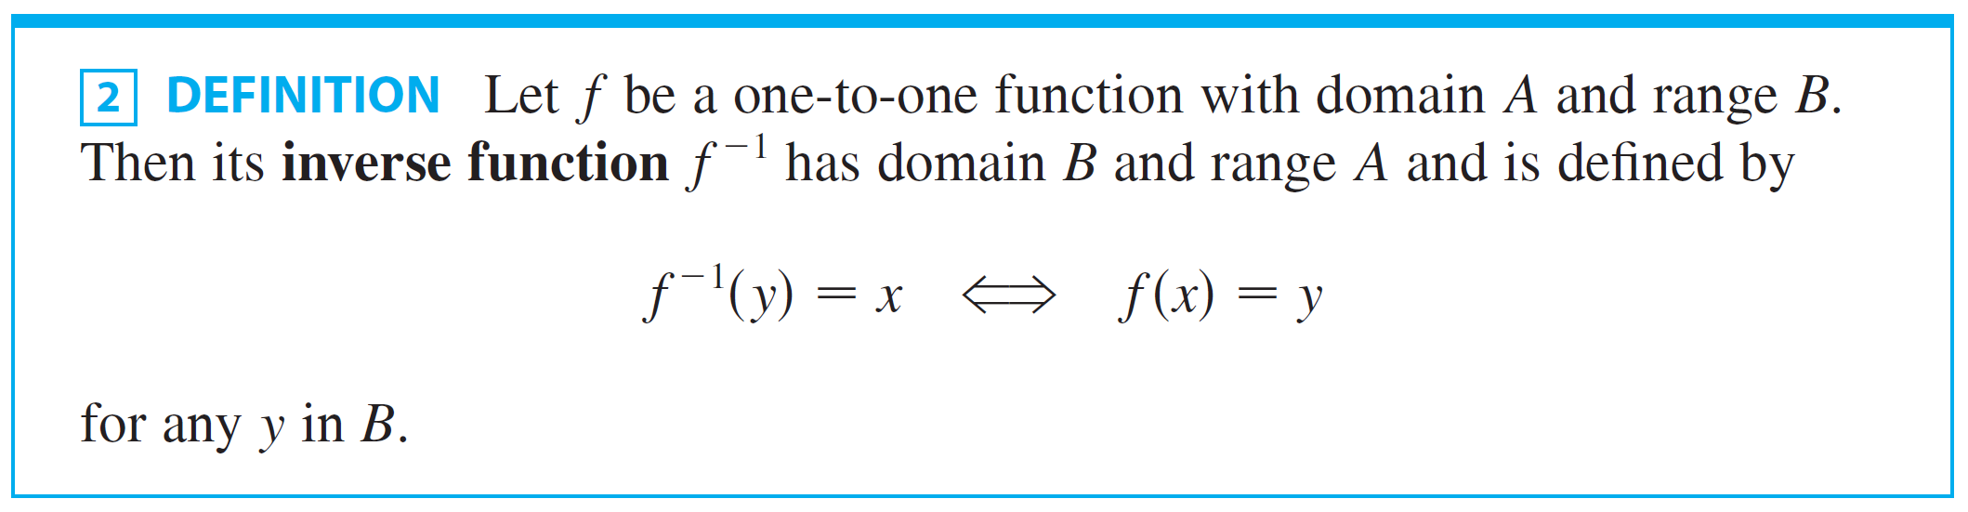
Inverse Functions
One-to-one functions are important because they are precisely the functions that possess inverse functions according to the following definition.

Slide 18
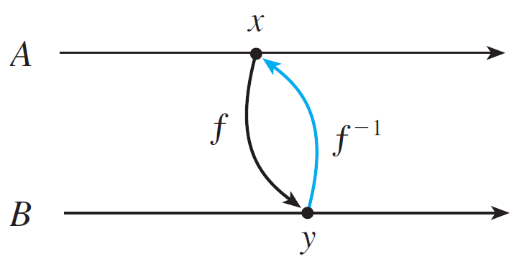
Inverse Functions
This definition says that if f maps x into y, then f ^{–1} maps y back into x. (If f were not one-to-one, then f ^{–1} would not be uniquely defined.) The arrow diagram in Figure 5 indicates that f ^{–1} reverses the effect of f.
Figure 5

Slide 19
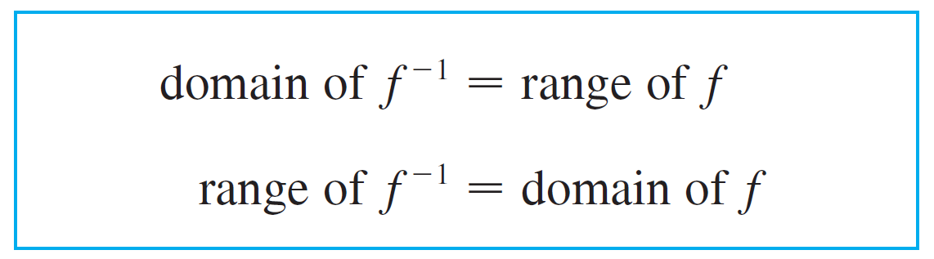
Inverse Functions
Note that
For example, the inverse function of f (x) = x³ is
f ^{–1} (x) = x^{1/3} because if y = x³ , then
f ^{–1} (y) = f ^{–1} (x³) = (x³)^{1/3} = x

Slide 20
Caution
Do not mistake the –1 in f ^{–1} for an exponent.
Thus, f ^{–1}(x) does not mean .
However, the reciprocal could be written as [f(x)]^{–1}.

Slide 21
Example 3
If f(1) = 5, f(3) = 7, and f(8) = -10, find f ^{–1}(7), f ^{–1}(5), and f ^{–1}(–10).
SOLUTION
From the definition of f ⁻¹, we have: f ^{–1}(7) = 3 because f(3) = 7 f ^{–1}(5) = 1 because f(1) = 5 f ^{–1}(–10) = 8 because f(8) = –10

Slide 22
Example 3 SOLUTION
This diagram makes it clear how f ^{–1} reverses the effect of f in this case.

Slide 23


Inverse Functions
The letter x is traditionally used as the independent variable, so when we concentrate on f ^{–1} rather than on f, we usually reverse the roles of x and y in Definition 2 and write:

Slide 24

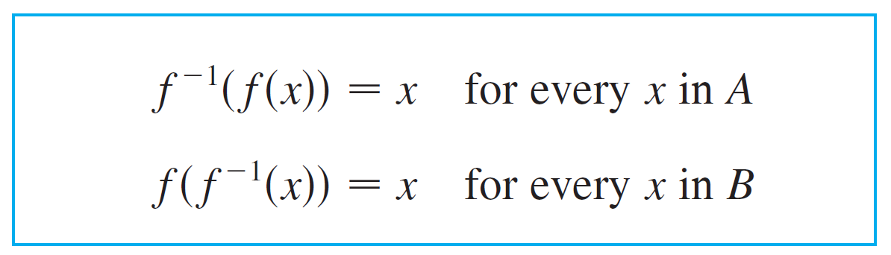

Inverse Functions
By substituting for y in Definition 2 and substituting for x in we get the following cancellation equations:

Slide 25

Inverse Functions
The first cancellation equation says that if we start with x , apply f , and then apply f ^{–1} , we arrive back at x , where we started (see the machine diagram below).

Slide 26
Inverse Functions
For example, if f (x) = x³ , then f ^{–1} (x) = x^{1/3} and so the cancellation equations become
f ^{–1}(f (x)) = (x³) ^{1/3} = x
f ( f ^{–1} (x)) = (x ^{1/3})³ = x
Those equations simply say that the cube function and the cube root function cancel each other when applied in succession.

Slide 27
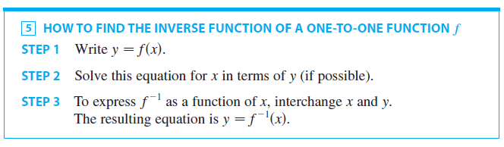
Inverse Functions
Now let’s see how to compute inverse functions. If we have a function f (x) and are able to solve this equation for x in terms of y , then according to Definition 2 we must have
x = f ^{–1} (y). If we want to call the independent variable x, we then interchange x and y and arrive at the equation
y = f ^{–1} (x).

Slide 28
Example 4
Find the inverse function of f (x) = x ³ + 2.

Slide 29

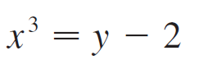

Example 4 - Solution
SOLUTION:
According to we first write,
Then we solve this equation for x:

Slide 30
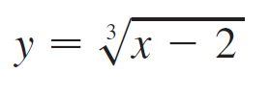

Example 4 - Solution
cont’d
Finally, we interchange x and y:
Therefore the inverse function is

Slide 31
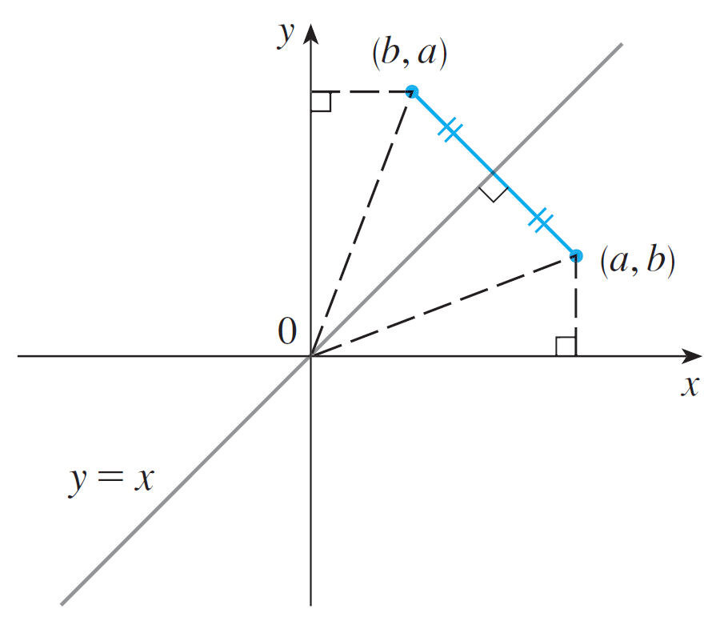
Inverse Functions
The principle of interchanging x and y to find the inverse function also gives us the method for obtaining the graph of f ^{–1} from the graph of f.
Since f (a) = b if and only if f ^{–1}(b) = a, the point (a, b) is on the graph of f if and only if the point (b, a) is on the graph of f ^{–1}. But we get the point (b, a) from (a, b) by reflecting about the line y = x. (See Figure 8.)
Figure 8

Slide 32
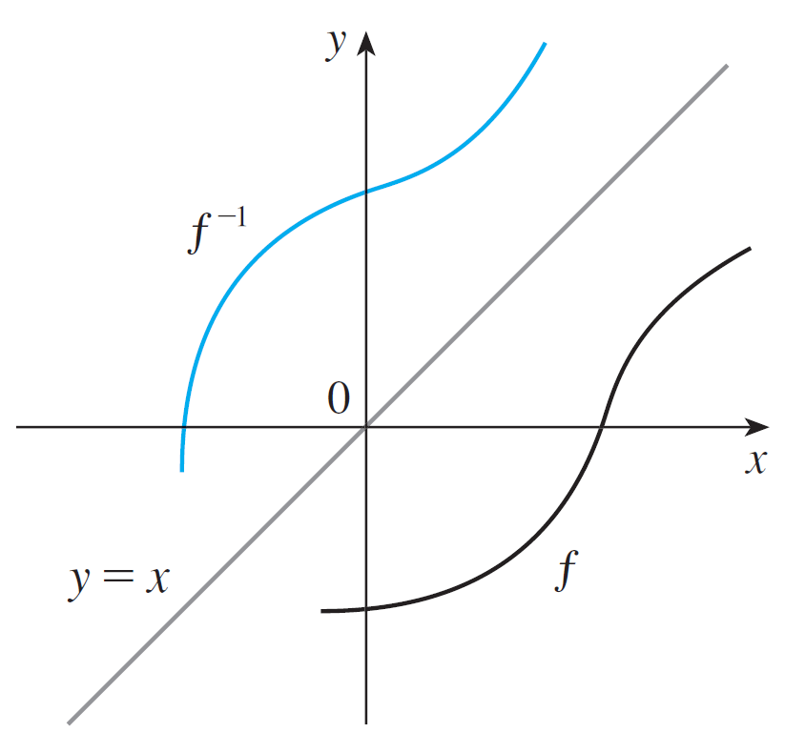
Inverse Functions and Logarithms
Therefore, as illustrated by Figure 9:
Figure 9

Slide 33

Example 5
Sketch the graphs of and its inverse function using the same coordinate axes.

Slide 34

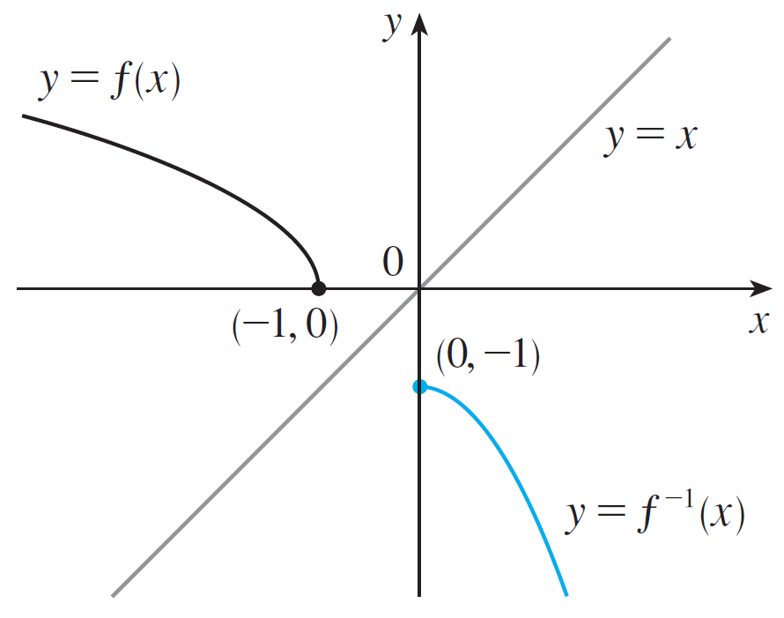
Example 5 – Solution
SOLUTION:
First we sketch the curve (the top half of the parabola
y² = –1 – x, or x = –y² – 1) and then we reflect about the line y = x to get the graph of f ^{–1}.(See Figure 10.)
Figure 10

Slide 35
Example 5 – Solution
cont’d
As a check on our graph, notice that the expression for f ^{–1} is f ^{–1}(x) = –x² – 1, x ≥ 0.
So the graph of f ^{–1} is the right half of the parabola y = –x² – 1 and this seems reasonable from Figure 10.
Figure 10

Slide 36
The Calculus of Inverse Functions

Slide 37
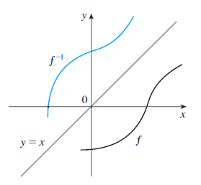
The Calculus of Inverse Functions
Now let’s look at inverse functions from the point of view of calculus. Suppose that f is both one-to-one and continuous. We think of a continuous function as one whose graph has no break in it. (It consists of just one piece.)
Since the graph of f ⁻¹ is obtained
from the graph of f by reflecting
about the line y = x , the graph of
f ⁻¹ has no break in it either
(see Figure 9).
Figure 9

Slide 38

The Calculus of Inverse Functions
Thus we might expect that f ⁻¹ is also a continuous function.
This geometrical argument does not prove the following theorem but at least it makes the theorem plausible.

Slide 39
The Calculus of Inverse Functions
Now suppose that f is a one-to-one differentiable function. Geometrically we can think of a differentiable function as one whose graph has no corner or kink in it.
We get the graph of f ⁻¹ by reflecting the graph of f about the line y = x , so the graph of f ⁻¹ has no corner or kink in it either.
We therefore expect that f ⁻¹ is also differentiable (except where its tangents are vertical). In fact, we can predict the value of the derivative of f ⁻¹ at a given point by a geometric argument.

Slide 40
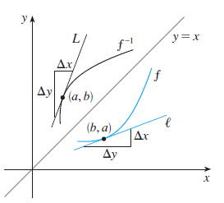
The Calculus of Inverse Functions
In Figure 11 the graphs of f and its inverse f ⁻¹ are shown.
If f(b) = a , then f ⁻¹ (a) = b
and (f ⁻¹)’ (a) is the slope of the
tangent line L to the graph of
f ⁻¹ at (a, b) , which is ∆y / ∆x.
Figure 11

Slide 41
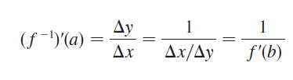
The Calculus of Inverse Functions
Reflecting in the line y = x had the effect of interchanging
the x and y coordinates. So the slope of the reflect line l
[the tangent to the graph of f at
(b, a)] is ∆x / ∆y.
Thus the slope of L is the
reciprocal of the slope of l , that
is,
Figure 11

Slide 42
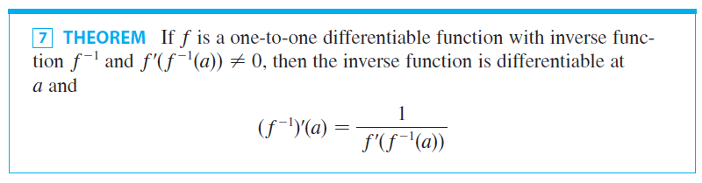
The Calculus of Inverse Functions

Slide 43
Theorem 7 PROOF
Write the definition of derivative as in Equation 5 in Section 2.1:
If f(b) = a, then f ^{–1}(a) = b.
Also, if we let y = f ^{–1}(x), then f(y) = x.

Slide 44
Theorem 7 PROOF
Since f is differentiable, it is continuous.
So f ^{–1} is continuous by Theorem 6.
Thus, if x → a, then f ⁻¹(x) → f ⁻¹(a), that is, y → b.

Slide 45
Theorem 7 PROOF
Therefore,

Slide 46


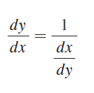
The Calculus of Inverse Functions
NOTE 1: Replacing a by the general number x in the formula of Theorem 7, we get
If we write y = f ^{–1}(x), then f (y) = x, so Equation 8, when expressed in Leibniz notation, becomes

Slide 47

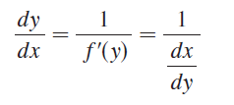
The Calculus of Inverse Functions
NOTE 2: If it is know that f ^{–1} is differentiable, then its derivative can be computed more easily than in the proof of Theorem 7 by using implicit differentiation.
If y = f ^{–1}(x), then f (y) = x. Differentiating the equation
f (y) = x implicitly with respect to x, remembering that y is a function of x , and using the Chain Rule, we get
Therefore

Slide 48
Example 6
If f (x) = 2x + cos x, find (f ^{–1})′(1).

Slide 49

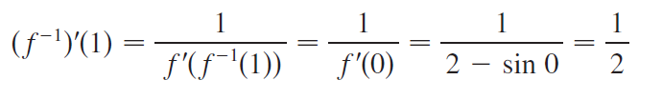
Example 6 – Solution
SOLUTION:
Notice that f is one-to-one because
f ′ (x) = 2 – sin x > 0
and so f is increasing. To use Theorem 7 we need to know f ^{–1} (1) and we can find it by inspection:
f (0) = 1 f ^{–1} (1) = 0
Therefore,

